Slide 1
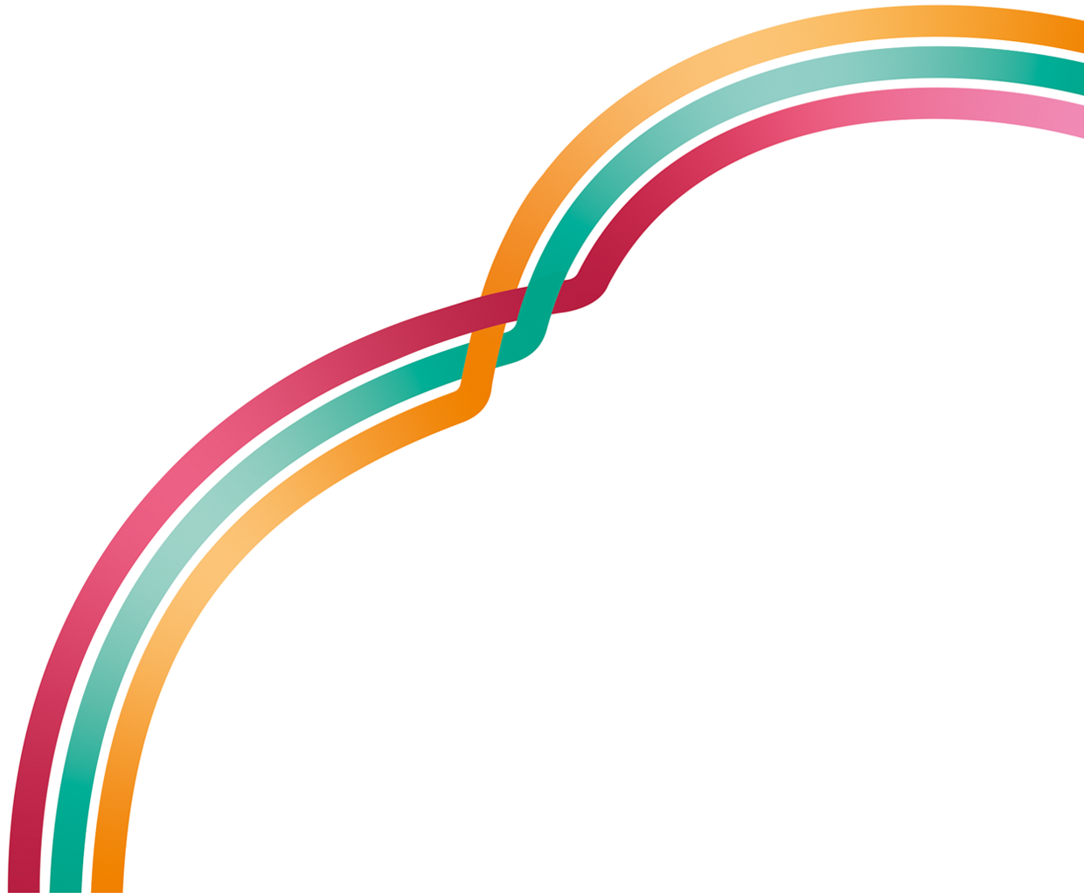
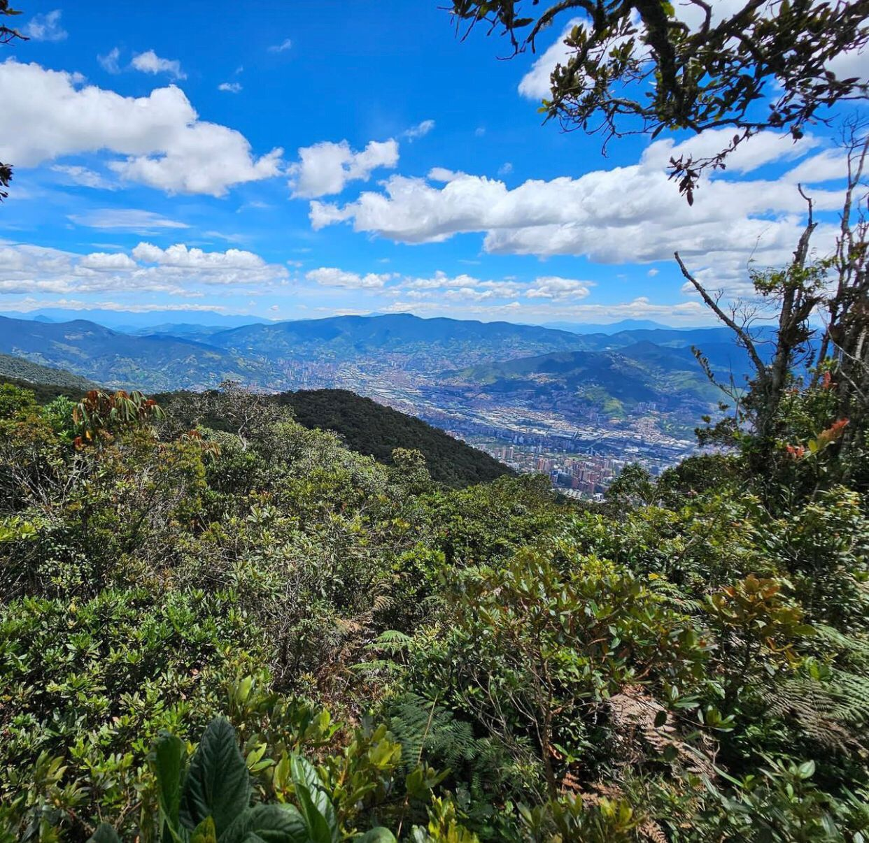
Grünzug Pleisenbach
Rethinking urban-rural linkages
for people and biodiversity
Envigado, Colombia. Nov 23-24
City of Chemnitz, Germany
Max Krombholz
Sarah Arnold

Slide 2
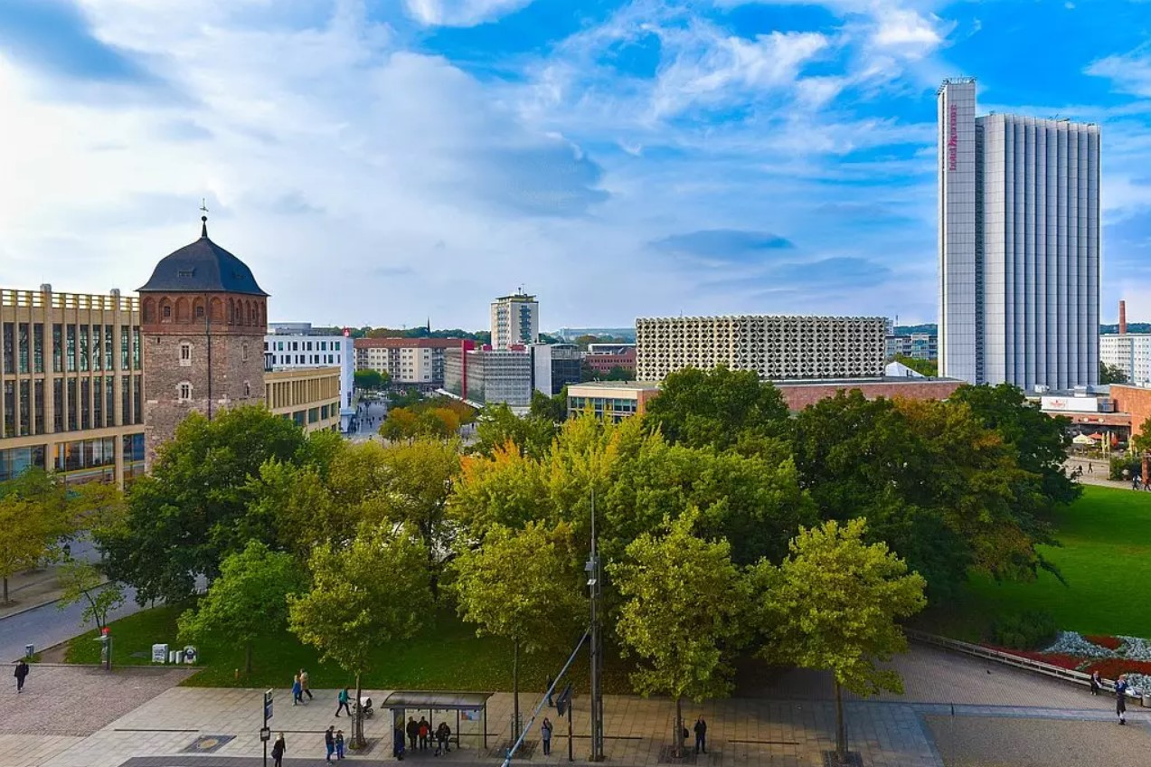
BACKGROUND
What were the main challenges to address?
The old coal train station and it’s remaing tracks acted like a barrier between the neighbourhoods and a deficit of green spaces was identified in the area. Furthermore the contaminated sites and the artificial creek embedment did not support biodiversity and a climate resilient neighbourhood.
City profile
Population of 250.945 / 221,03 km2
297 above sealevel; at the foothills of the ore-mountains in Saxony, located in the east of Germany

Slide 3
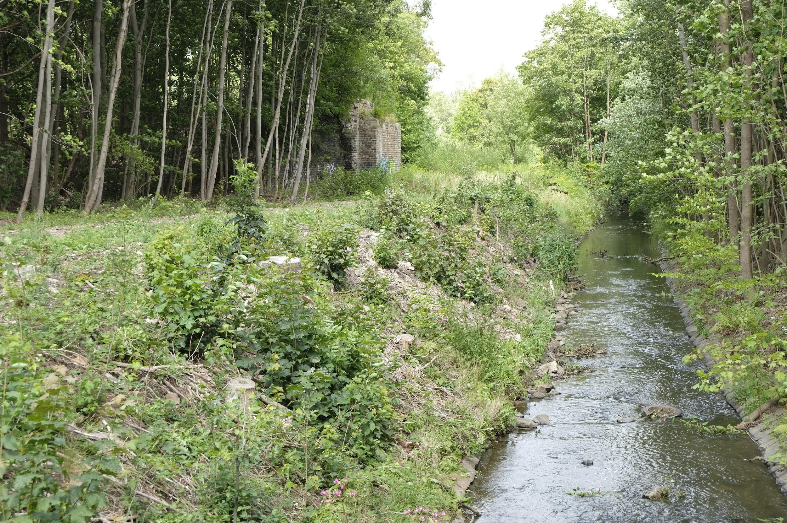
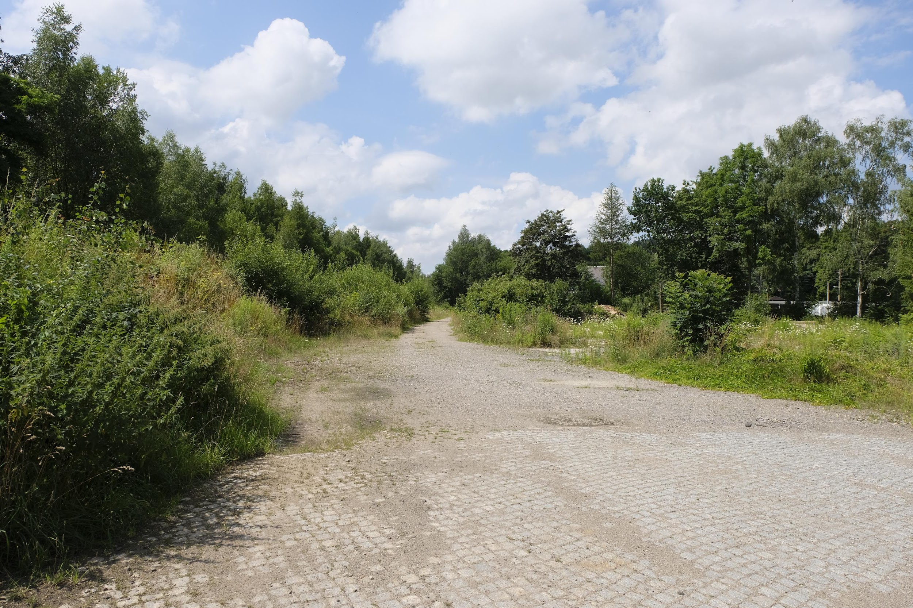
APPROACH
What is being done?
Revitalization of an old coal train station including it’s creek into a neighbourhood-park, housing and a bicycle track.
The newly created bicycle track along the old train tracks connects the urban areas of Chemnitz with the outskirts and beyond.
The revitalization of the overbuild and straightened creek as well as the creation of the Pleisenpark are examples for NbS in the project.
What was your starting point?
Project idea: 2016
funding area concept: 2017
Planning and approval phase: 2018 – 2023
Construction: 2023 - 2027

Slide 4
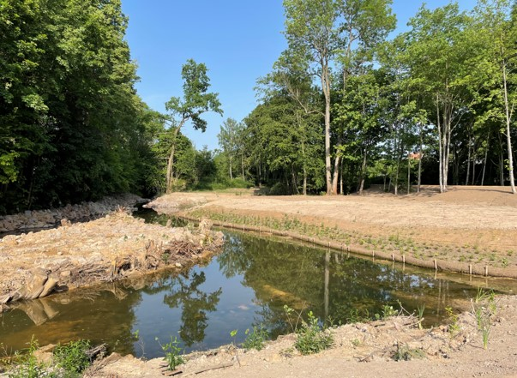
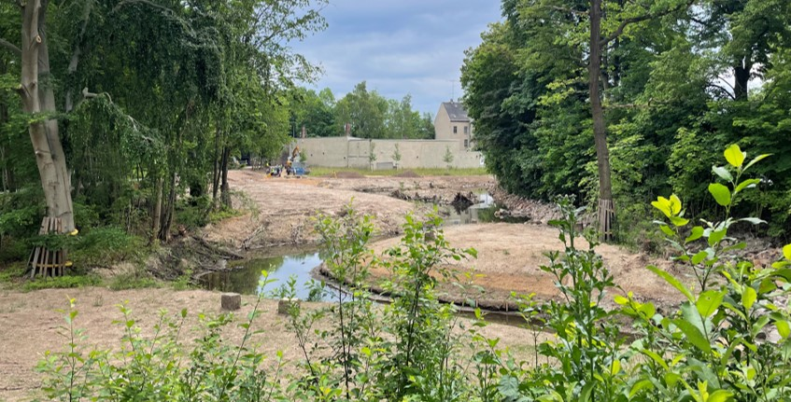
METHODOLOGY
What tools, instruments, or methodologies were used or developed?
A regular specialist planning was used.
We had to obey the standard and legally prescribed processes in the approval procedure.
Regular meetings of the project group consisting of all involved departments.
Who is leading? Who is engaged / partnering?
Leading: Green Space Department (technical); City Planning Office (administrative)
Engaged: different planing and enginering offices
How is the action funded? Who is contributing - financially and in-kind?
The action is funded by different national and federal funding programs with a total volume of 17 million €.

Slide 5
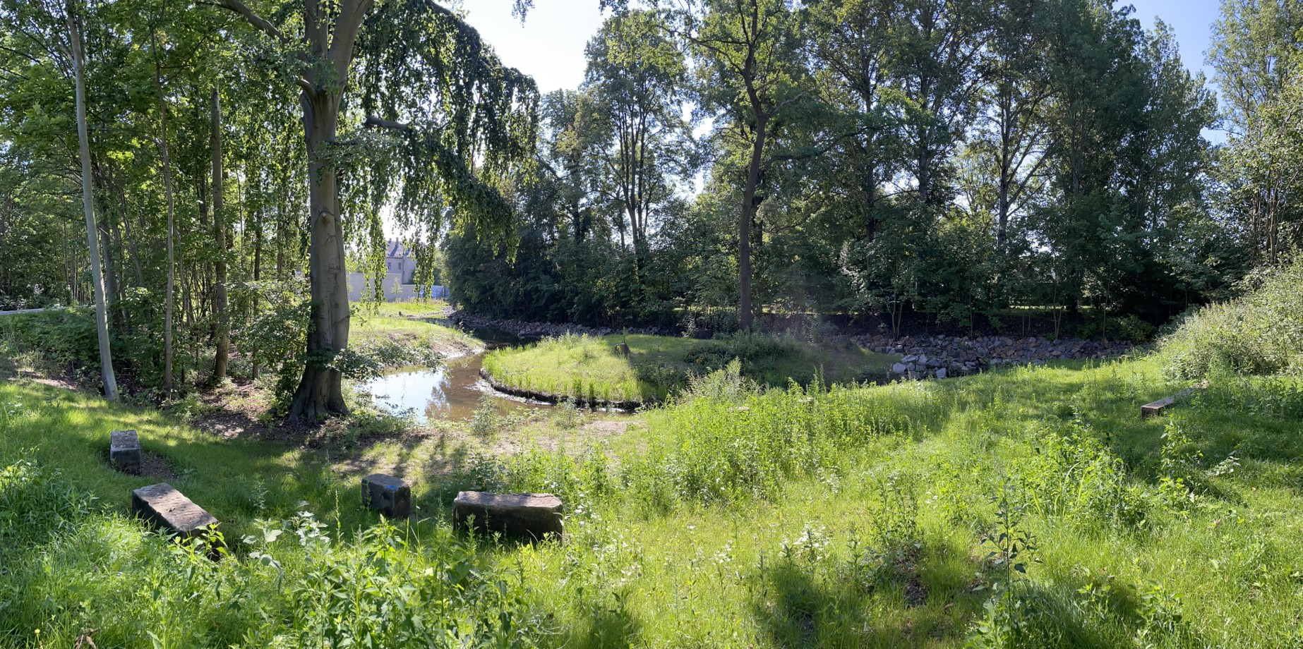
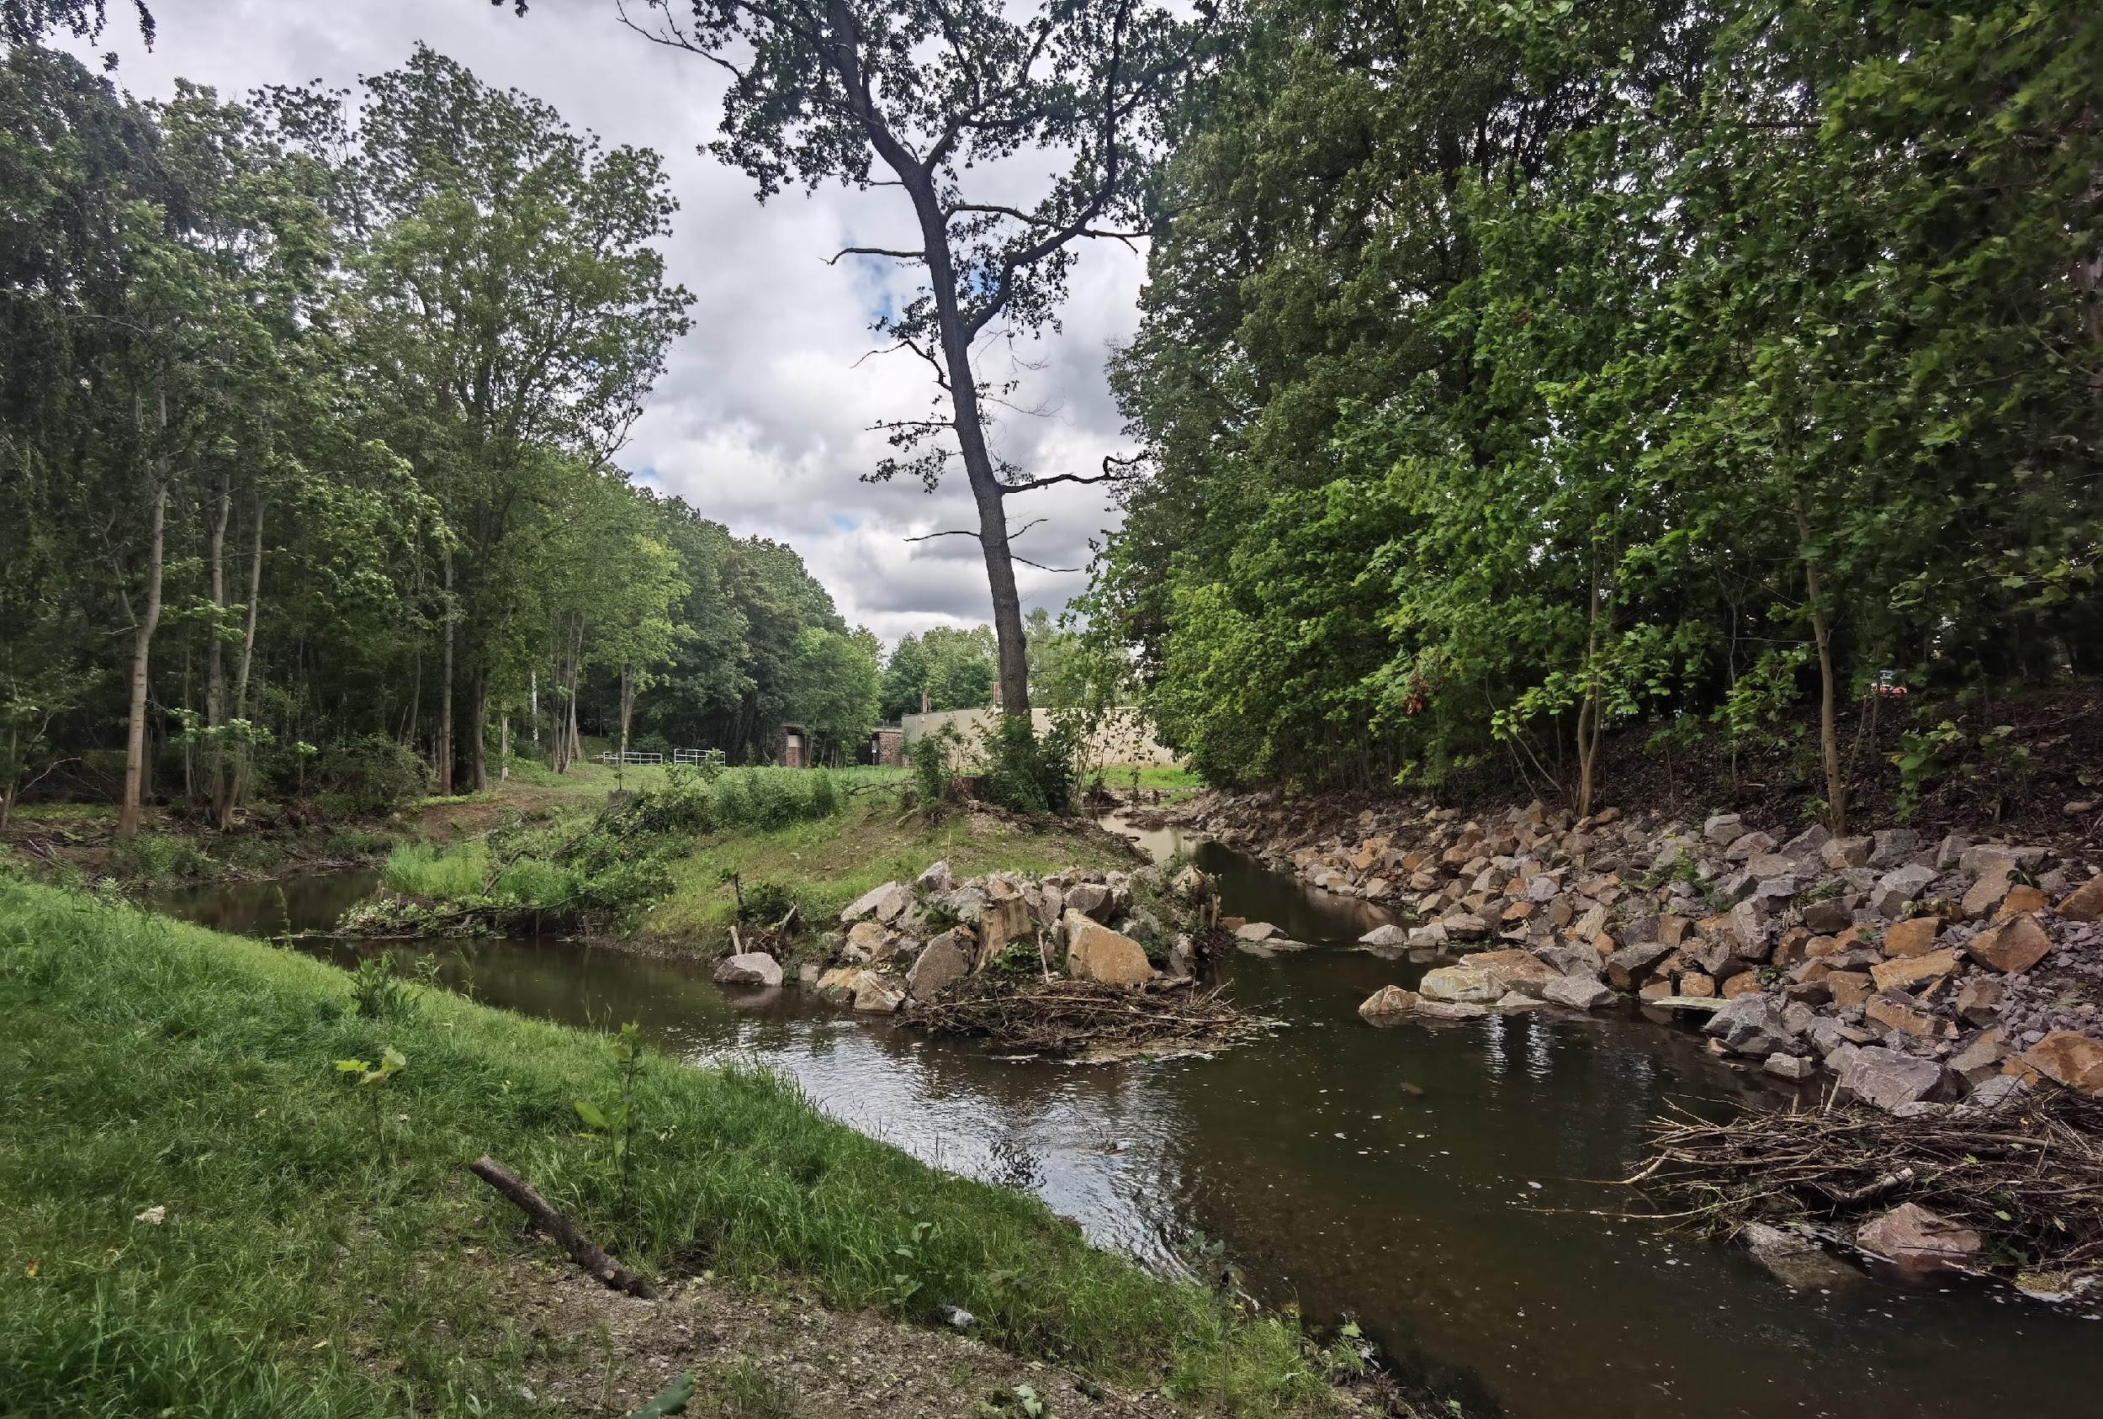
OUTCOME
Add photo of project’s outcomes
(Please also share original image file in PNG / JPG format with high definition)
What was achieved?
People: Recreational area, low-barrier and inclusive natural space, supra-regional networking of regions via the cycle path
Nature: Watercourse renaturalisation, flood protection, species-rich natural areas, development of typical local flora and fauna, climate protection, climate adaptation and cold air corridor
Next steps
Construction is expected to last untill 2027 and beyond.
Possible replication of the watercourse renaturalisation for the Gablenzbach.
Add photo of project’s outcomes
(Please also share original image file in PNG / JPG format with high definition)

Slide 6
LESSONS LEARNED
Key lessons of the process
elements for success: -Generous funding provided by the federal state and the federal government and close cooperation with the funding body have ensured the success of the project over all hurdles to date. -Land acquisition from Deutsche Bahn -Preparation of a development plan as the basis for reallocation procedures -Early involvement and close cooperation of the various specialist departments on many individual issues
improved: -Cooperation between the various specialist departments (it worked well in many places, but there was still room for improvement in others)
inspire: -Implementation process is very transferable to other municipalities and similar projects -Multifunctionality of the area is exceptional/exemplary

