Slide 1
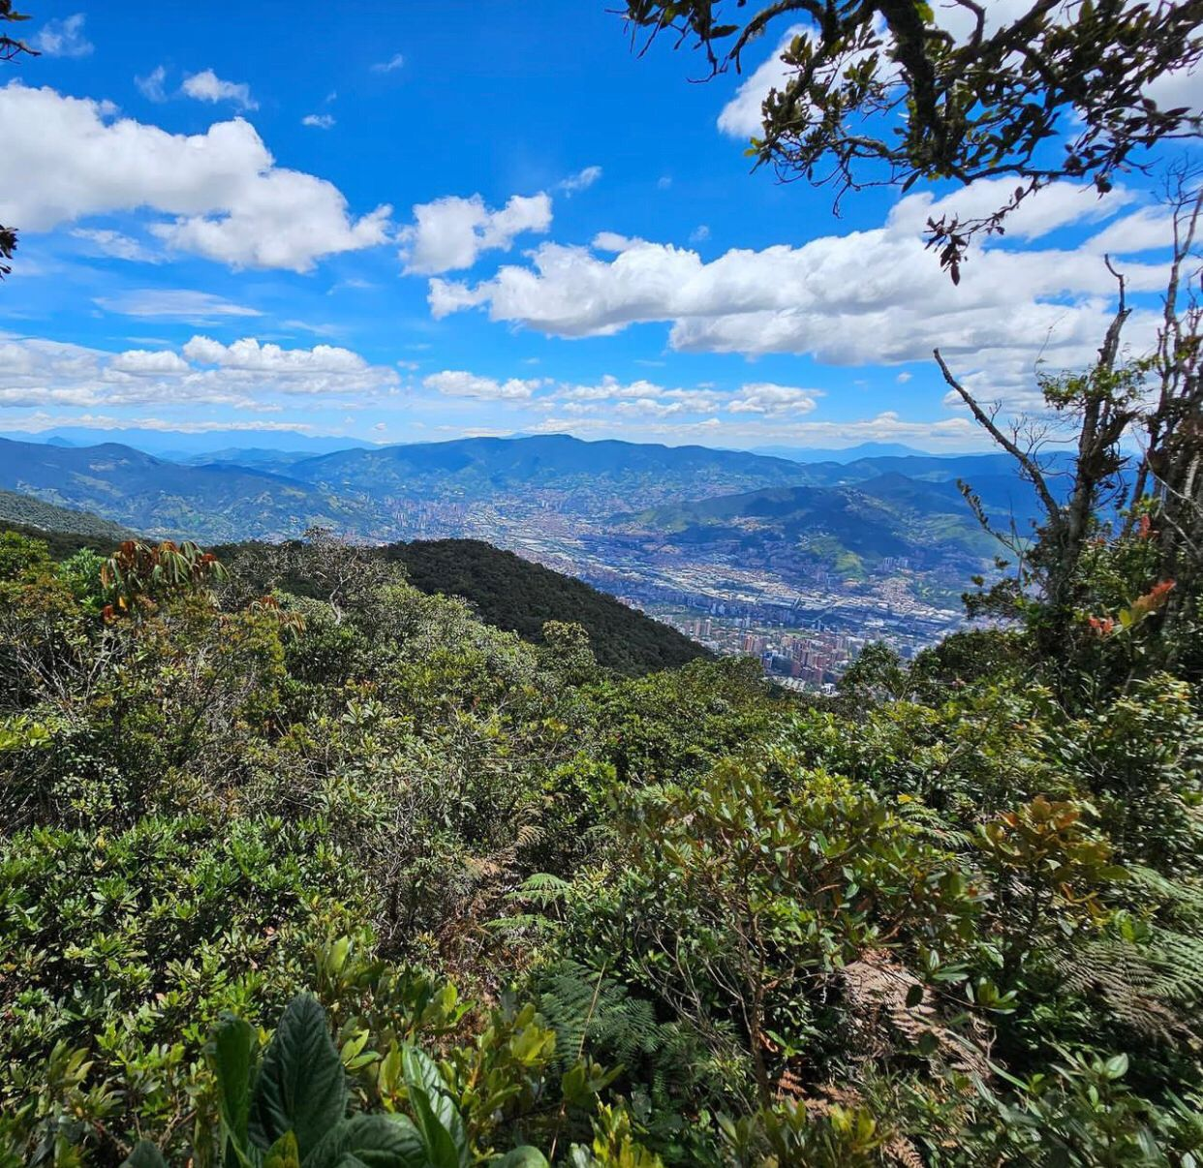
Blue Pearls for Berlin
Rethinking urban-rural linkages
for people and biodiversity
Envigado, Colombia. Nov 23-24
Berlin, Germany
Sandra Naumann

Slide 2
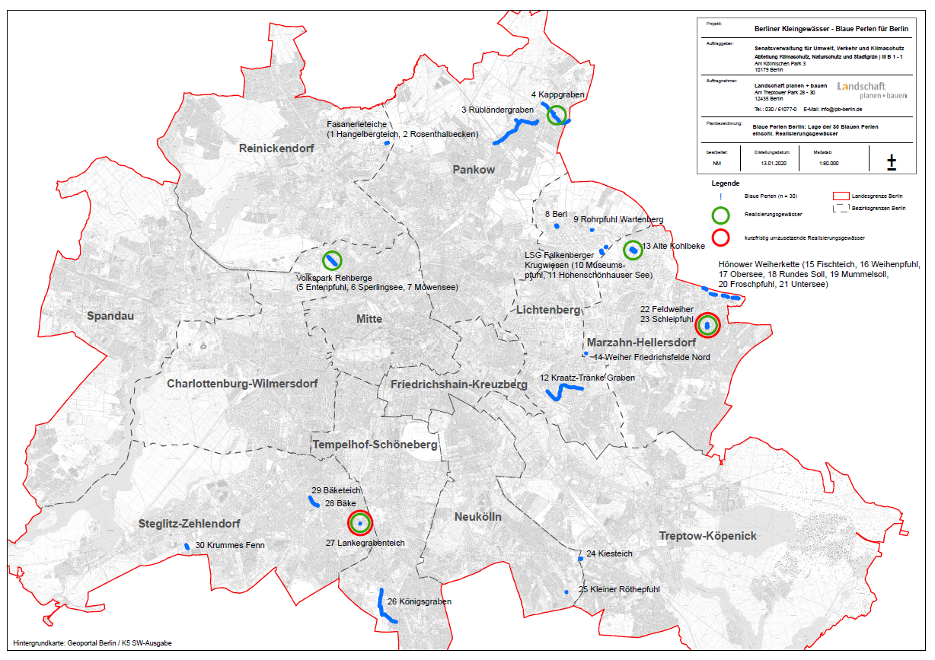
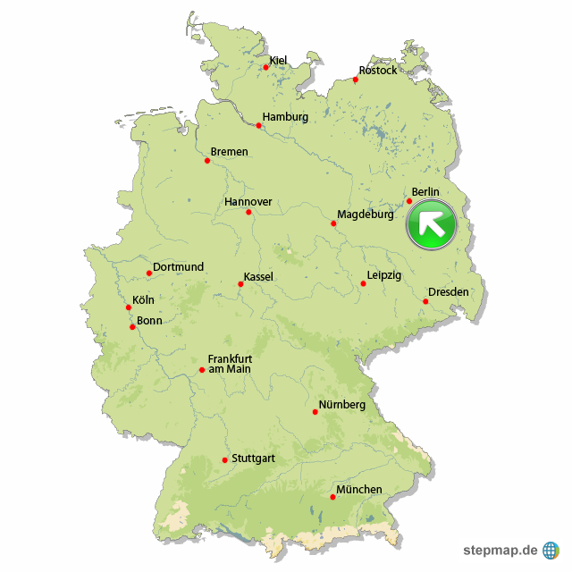
BACKGROUND
What were the main challenges to address?
Deterioration of habitats and its biodiversity
Climate change
Loss of recreation areas
City profile
3,76 Mill inhabitants/ 892 km²

Slide 3
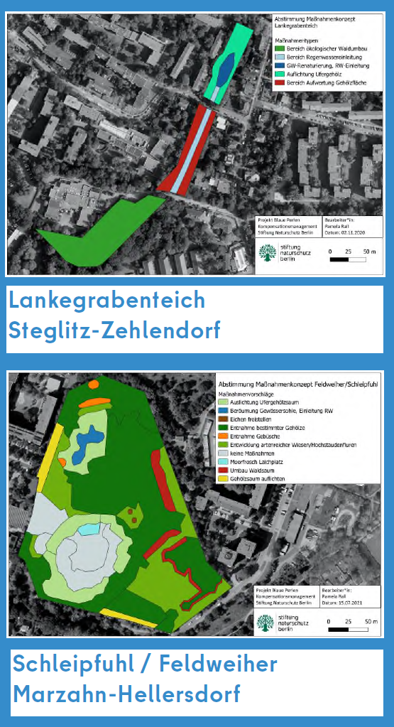
APPROACH
What is being done?
As part of the Berlin eco-account, 30 small water bodies and their surroundings will initially be ecologically upgraded and revitalized to provide animals and plants with diverse habitats and Berliners with new nature experiences in the city.
What was your starting point?
The increasing drought in recent years has led to a severe water shortage in ponds and small lakes, some of which have completely dried up and disappeared, and with them many animals and plants. In addition, many areas are being sealed and are no longer available for rainwater harvesting and support the water balance in the soil or in small bodies of water. In order to address this problem and improve the ecological situation of some endangered bodies of water, the City of Berlin started the "Blue Pearls for Berlin" eco-account project in February, 2022. In first phase revitalization measures are implemented in two pilot projects.

Slide 4
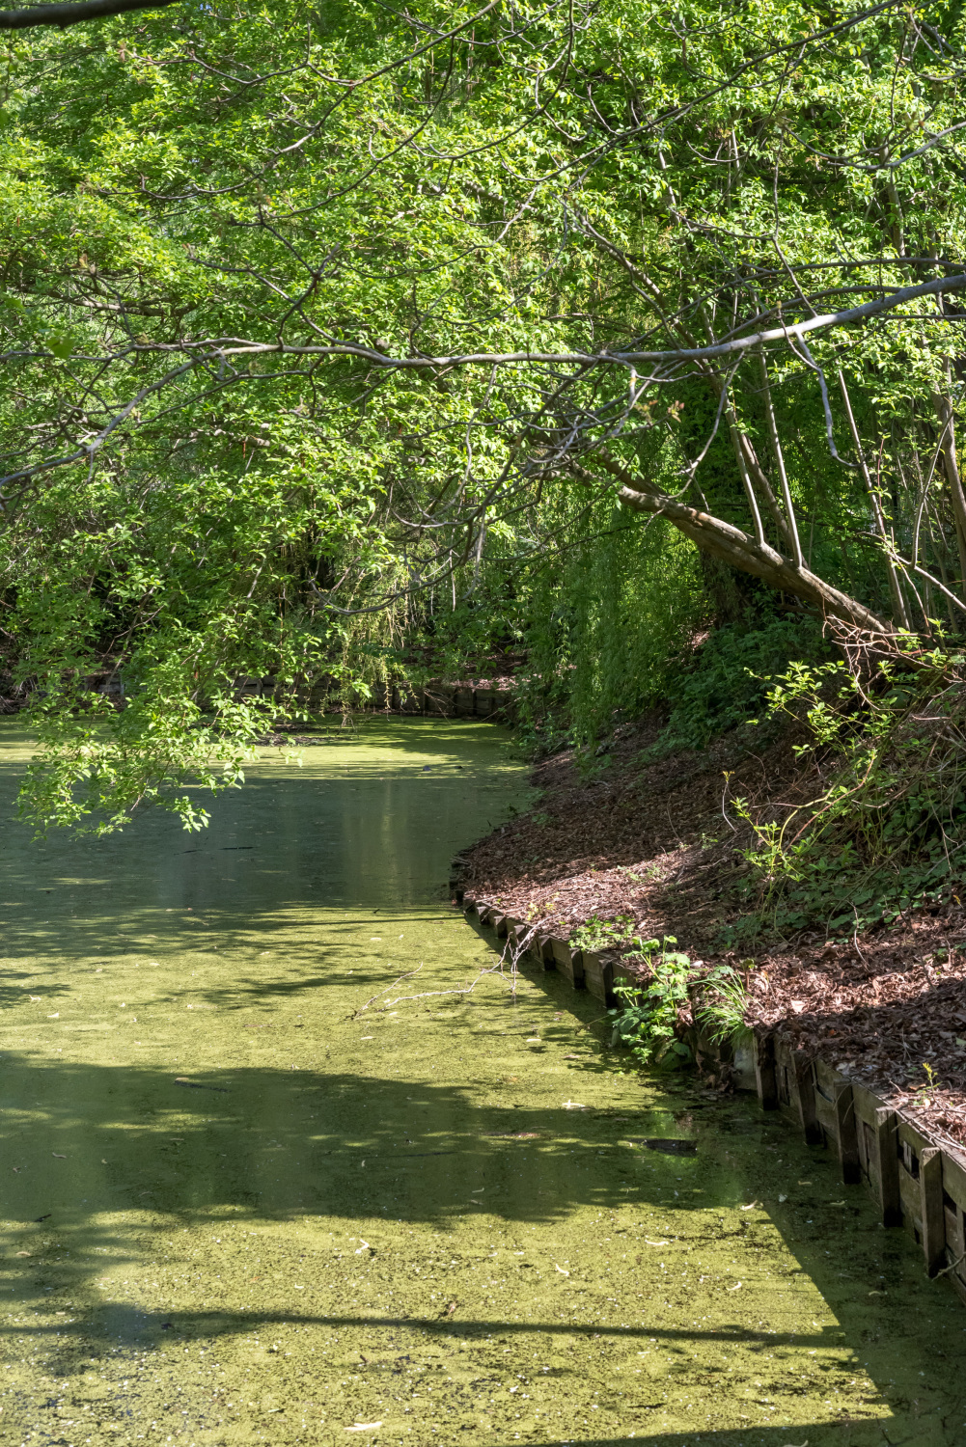
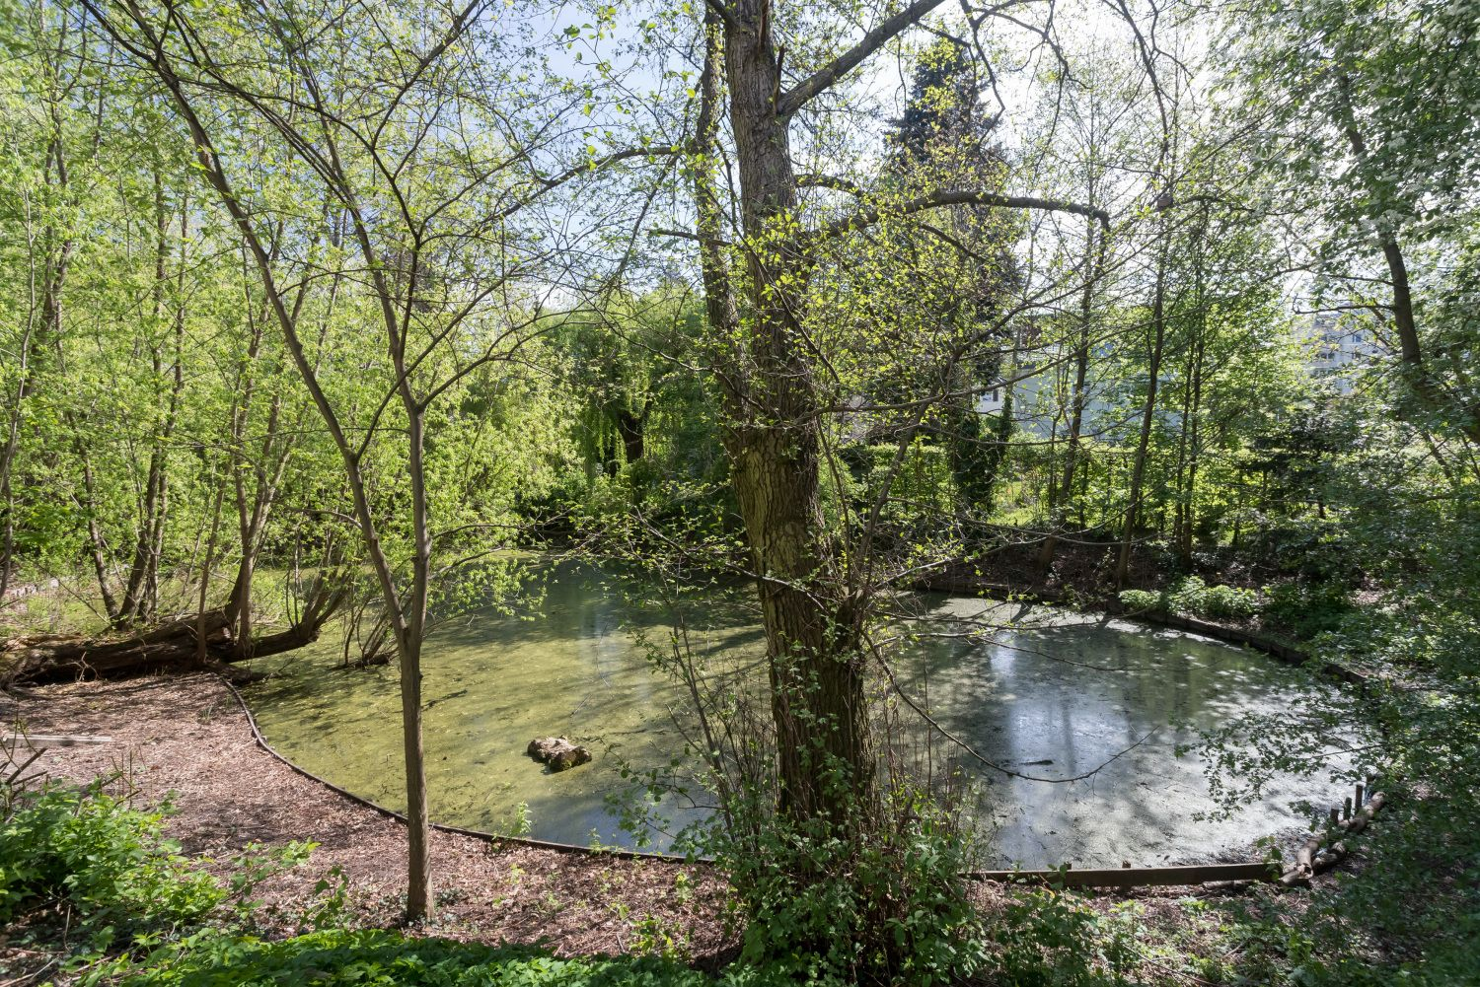
METHODOLOGY
What tools, instruments, or methodologies were used or developed?
The Berlin eco account is an instrument of city-wide compensation management to mitigate the ecological consequences of major construction projects and at the same time to secure and strengthen Berlin's green infrastructure. The city implements early compensation measures for expected interventions in nature and the landscape and stores the "eco-points" gained in this way.
Who is leading? Who is engaged / partnering?
The initiative is led by the City of Berlin (Senate Department for Urban Mobility, Transport, Climate Action and the Environment and implemented in cooperation with the Berlin Rainwater Agency, the Foundation Nature Conservation Berlin, Berliner Wasserbetriebe and Berlin districts.
How is the action funded? Who is contributing - financially and in-kind?
The state of Berlin makes advance payments for the planning and implementation of the measures, using city funds such as for example, the Berlin Programmes for Sustainable Development or Energy and Climate. National funds are also being used.

Slide 5
OUTCOME
What was achieved?
The project ist still in an early phase, but aims to:
Increase biodiversity by restoring small water bodies and improving the conservation status of species and habitats
Adapt to climate change by increasing the resilience of urban nature and increase cooling potential of open water areas.
Facilitate decentralized rainwater management by stabilizing the water balance, mitigate flood risks and increase evaporation capacity.
Next steps
Implementation of pilot projects and roll-out to other areas
Mobilising further funding for the revitalisation and restoration of the identified water bodies.

Slide 6
LESSONS LEARNED
Key lessons of the process
The project pursues an integrated planning approach and requires cross-departmental and cross-stakeholder cooperation, which is crucial for successful implementation.
The selection of areas is based on the landscape programme, a strategic, city-wide planning instrument for integrative environmental precautions, ensuring their relevance.
Sufficient funding is required to realize the project, which must be acquired primarily by the city.
A state-wide 'Future of Berlin's Small Waterbodies' programme is needed to stabilize the water balance, ensure good water quality, allow for revitalization of the water bodies and optimize the design with regard to biodiversity diversity in the entire city.

