Slide 1

City NBS Tool
Gathering ideas, getting started…!

Slide 2
Workshop Programme
Introduction to the City NBS Tool
Creating the user stories
Identifying the ‘building blocks’ of the tool
Focus and USP: what can the tool do best?

Slide 3

City NBS Tool ☺

Slide 4
From the Grant Agreement:
Task 5.4 Developing a City NBS Tool for ecosystem restoration and rehabilitation
(lead: OPPLA; contributing partner: ECO, UNA, UAB, HI, YES, TSF, CA, UNGL, UCLG/NAN) (M24-M46)
Collate and repurpose key products of the project to create an innovative web-based decision-support tool to guide the planning, design, implementation, maintenance and monitoring of restorative urban NBS.
The City NBS Tool will be featured on the Innovation Hub and provide an intuitive, user-led approach to accessing the outputs of the project in a format that focuses on helping cities ‘package-together’ solutions specific to their individual needs.
Content will include case studies, tried-and-tested tools/methods and good practice guidelines relevant to different scales and contexts.
By making these products more accessible and customisable, the City NBS Tool will facilitate the uptake of restorative NBS in national and city-level planning and decision-making processes. Moreover, the City NBS Tool will help to facilitate restorative NBS implementation by building capacities, generating knowledge, and providing guidance on how to adopt and apply new solutions to urban ecosystem restoration.

Slide 5
Potential ‘building blocks’…
D1.1 Agile Workflow guidance
D1.5 INTERLACE stakeholder engagement strategy
D2.3 Urban NBS Governance Atlas
D3.1 Database of good practice tools
D4.2 Cookbook on interactive exchange formats for cities
D5.5 CELAC Repository of NBS (INTERLACE Hub): Project outputs database
D5.7 Distance learning course

Slide 6







Other sources…?

Slide 7

Key ingredients of the tool…

Slide 8
1. CONTENT

Slide 9
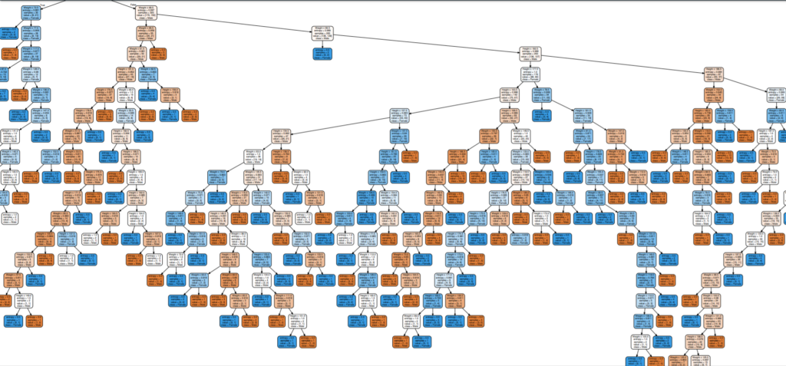
2. DECISION-TREE

Slide 10
3. INTERFACE AND USER EXPERIENCE (UX)

Slide 11

Suggested team roles…
Oppla: project management and IT/software (building the tool)
Ecologic: coordinating and curating content
INBO: facilitating agile workflow / user testing
Others: formatting and supplying content
All: developing the decision tree

Slide 12
Pitfalls and solutions…
What can go wrong? | How we’ll make it go right…
Over-ambition / over-complication | Be clear about target audiences Be clear about product purpose Keep it simple: do a few things well, instead of trying to do lots of things (badly!)
Insufficient / inconsistent / inferior content | Let the content determine the functionality Make the content consistent as soon as possible If something doesn’t fit, then ditch it… Don’t forget the decision-tree!
Difficulties maintaining and updating | Build open source using an easy CMS Be careful about which data sources you depend on Be realistic about data ‘use-by dates’
User-unfriendly design | Invest in the user experience Design to fit user workflows “Form follows function” Ditch the user manual

